Slide 1
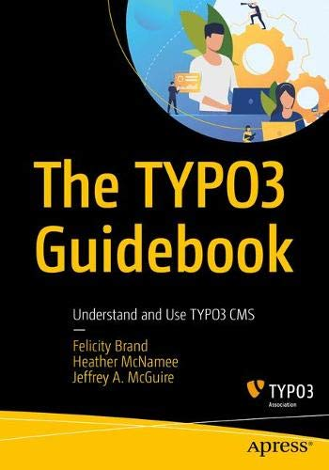
The TYPO3 Guidebook
Understand and Use TYPO3 CMS
By Felicity Brand, Heather McNamee, Jeffrey A. McGuire
#typo3guidebook
Notes:
Structured in a way to suit different audiences
Guides and practical hands-on tutorials
Involving 30 experts from the TYPO3 community
Showing the best way to get started with TYPO3

Slide 2
In two parts
Part 1. Overview tour
Part 2. Hands-on guides
https://typo3.org/article/the-typo3-guidebook-is-available-for-pre-order
Notes:
The book structure echoes the modularity of the TYPO3 system itself. There’s a “core” with the essentials, and then guides are like extensions to adapt TYPO3 to your needs.

Slide 3
What is in the Book?
Part 1: An overview tour.
TYPO3 Showroom. See what others have done with TYPO3, demonstrating the features and strengths.
Designing and Planning with TYPO3. See how you’d plan a site, taking into account TYPO3’s approach to layouts and functionality.
Building and Extending TYPO3. What you need to know about TYPO3 so you can build sites efficiently.
Launching and Maintaining TYPO3. Find out what typical maintenance is required, and set expectations around updating and upgrading.
Notes:
The book starts with a broad overview to help business analysts, project managers, and consultants understand TYPO3 capabilities. “The first part contains four chapters that could give anyone with a technical background insight into how TYPO3 works,”

Slide 4
What is in the Book?
Part 2 - Modular step-by-step tutorials
Installing TYPO3
Creating your first TYPO3 site
Extending TYPO3
Plan, build, and use content elements
Create your first standalone extension
Creating a password-protected members’ area
Translate your site
Configure content management workflow
Making TYPO3 successful for your business
Debugging and troubleshooting
Notes:
This is followed by a series of essential guides to show how to get up and running with TYPO3. Guides include clear learning outcomes and scenarios to make it easy for the reader to choose. This provides the reader with insight into “why” as well as the step-by-step “how.”

Slide 5
Buy it,
share it, review it!
Enjoy!
Notes:
This book fills in a gap for those who are new to TYPO3. There are already a number of TYPO3 books for TYPO3 developers such as TYPO3 Extbase or for those preparing for certification, such as the TYPO3 CMS Certified Integrator Study Guide, both by Michael Schams. The TYPO3 Guidebook also lays the foundation for future TYPO3 books and e-books to delve into niche topics in more depth, without having to cover all the bases again.

Slide 6
THANK YOU!

Slide 7
Discounts and offers for events
Want to share the love?
Apress can offer a discount code for larger conferences, or provide a PDF as part of a raffle, for example. Apress needs 2 weeks’ notice to get coupon codes so please make sure you give us as much notice as possible!
Contact jesi@openstrategypartners.com
Notes:
If you’re hosting the meetup - make sure to contact us for a discount!

