Slide 1
TYPO3 v10 LTS
Safe and Sound
www.typo3.org
Inspiring people to share

Slide 2
TYPO3 enables people to deliver content-rich digital experiences on any channel, any device, in any language.

Slide 3
Start small and grow fast. Welcome to Enterprise Any-size.

Slide 4
Making TYPO3 v10 LTS

Slide 5
SECURITY AND STABILITY are the Top TYPO3 Priorities
Benjamin Mack, TYPO3 Core Lead

Slide 6
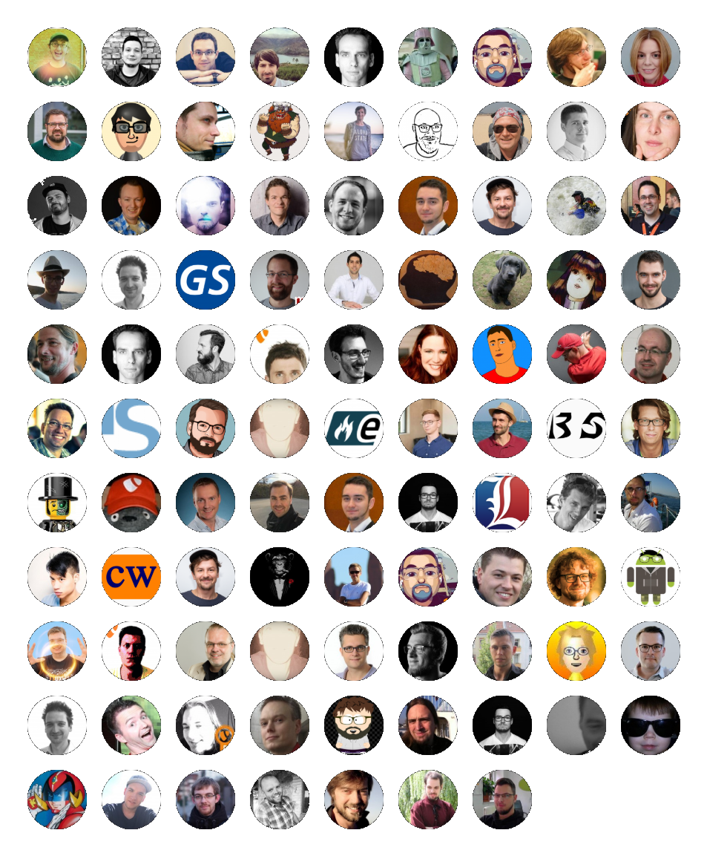
566 Days 265 Contributors 2.706 Commits
https://github.com/TYPO3/TYPO3.CMS/graphs/contributors

Slide 7
4 Commits a Day 9.837 files changed 213.577 LOC* removed 284.874 LOC* added
* Lines of Code

Slide 8
highlights of TYPO3 v10 LTS

Slide 9
Dashboard Get an overview of important system information and statuses.

Slide 10
New Dashboard after Backend Login

Slide 11
Customized Dashboard Widgets

Slide 12
Use predefined widgets or build your own.

Slide 13
Dashboard
Quick overview of important system information and statuses
Information summary is displayed in widgets
A wide range of types and styles are available out of the box
Customize and extend own widgets
Configure multiple dashboards and easily switch between them

Slide 14
HTML-Based Templated Emails Implement customized email templates for TYPO3 core emails.

Slide 15
Customized system notification emails

Slide 16
HTML-Based Templated Emails
TYPO3’s system emails are template-based HTML emails now
Using the Fluid templating engine
Customize system-generated notification emails with individual colors and brand logo

Slide 17
SameSite Cookies Improved User’s Privacy with SameSite Cookies.

Slide 18
Improved User’s Privacy with SameSite Cookies

Slide 19
Improved User’s Privacy with SameSite Cookies
Define whether to share certain information (e. g. session cookie) with third-party sites if scripts or iframes are used on a site for example
Frontend session cookies are set to “SameSite=Lax”
Backend session, Install Tool session and workspace cookies are set to the more restrictive “SameSite=Strict”
The SameSite cookies feature has also been implemented in TYPO3 v8 and v9

Slide 20
System Extension “Form” Easily create beautiful forms with the enhanced wizard.

Slide 27
Improved system extension Form
Enhanced form creation wizard that supports navigating to previous steps and descriptive labels such as “Start” or “Finish
Streamlined setup and an optimized configuration structure
Only one general configuration file “FormSetup.yaml” is used

Slide 28
Fluid-Based Frontend Login Form Frontend Login that just works.

Slide 29
Frontend login – fluid-based template

Slide 30
Frontend login – feature toggle

Slide 31
Fluid-Based Frontend Login Form
Fluid enables the modification of templates more easily
Send out HTML-based password recovery emails
Adjust and modify validators to enforce password restrictions

Slide 32
Event Dispatcher: More PSR-14 Events Developer Joy through Standardization

Slide 33
PSR-14 Event Listener Configuration

Slide 34
PSR-14 Event Listeners

Slide 36
PSR-14: Developer Joy through standardization
Hooks and the Signal/Slot concept is one of TYPO3’s superpowers
Introducing PSR-14 events standard
Extend the core and system functionality more efficiently
Easier for new developers to get up-and-running and familiar with TYPO3

Slide 37
Improved Extension Manager Links to extension documentation in Extension Manager.

Slide 38
Links to extension documentation in Extension Manager

Slide 39
Detect conflicting redirects Making the lives of SEO specialists a lot easier.

Slide 40
Detecting conflicting redirects in the report's module and CLI command

Slide 41
Slug update for page with sub pages

Slide 42
Notification on slug updates and generated redirects

Slide 43
Auto-generated redirects

Slide 44
Detect conflicting redirects
Detect conflicting redirects now
End users won’t end up on dead links
Automatically updates the relevant slugs for all sub-pages and can create redirects from the old to the new URL
TYPO3’s Link Validator aims to detect broken links throughout the system

Slide 45
Many more new and exciting features are waiting for you typo3.org/help/documentation/whats-new/

Slide 46
Maintenance and Support for a Full Six Years first three years free of charge by the TYPO3 community (1.5 years of full regular maintenance plus another 1.5 years of priority bug fixing with security fixes and critical updates). The paid Extended Long-Term Support (ELTS) will be available until April 20, 2026.

Slide 47
Get.typo3.org

